Slide 1
Model View Controller
Software Design and Architecture

Slide 2
Model View Controller
Model–View–Controller (MVC) is an architectural pattern that splits interactions between users and applications into three roles:
  the Model (business logic),
  the View (user interface),
  and the Controller (user input).
This separation of concerns facilitates the independent development, testing, and maintenance of each role.

Slide 3
Model
The Model
  manages the behavior and data of the application domain,
  responds to requests for information about its state
  and responds to instructions to change state

Slide 4
View
The View
  renders the model into a form suitable for interaction, typically a user interface element.
Multiple views can exist for a single model for different purposes.

Slide 5
Controller
The Controller
  receives user input and initiates a response by making calls on model objects.
A controller accepts input from the user and instructs the model and a view port to perform actions based on that input.

Slide 6
MVC Conceptualization
The MVC paradigm is a way of breaking an application into three parts:
  the model, the view, and the controller.
MVC was originally developed to map the traditional input, processing, output roles into the GUI realm:
  Input --> Processing --> Output
  Controller --> Model --> View

Slide 7
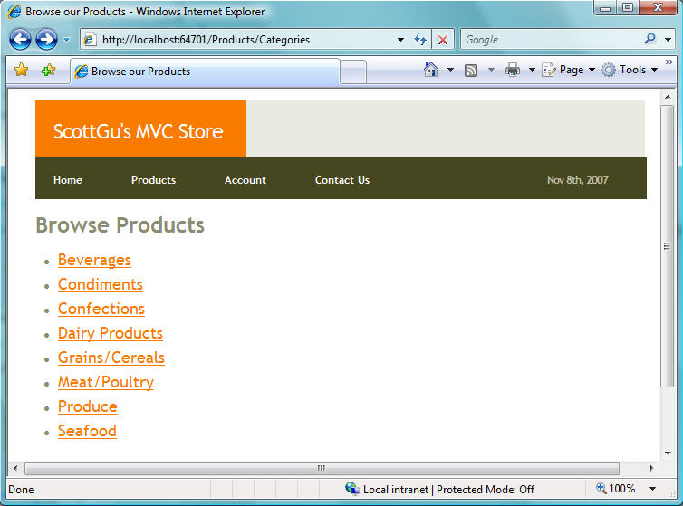
Example: E - Store
Ref : http://weblogs.asp.net/scottgu/archive/2007/11/13/asp-net-mvc-framework-part-1.aspx

Slide 8
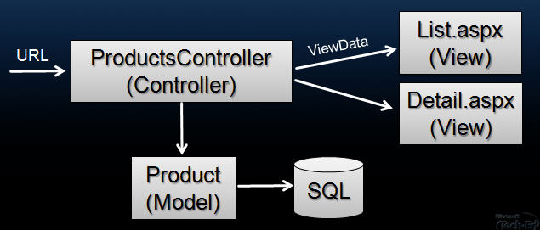

Slide 9
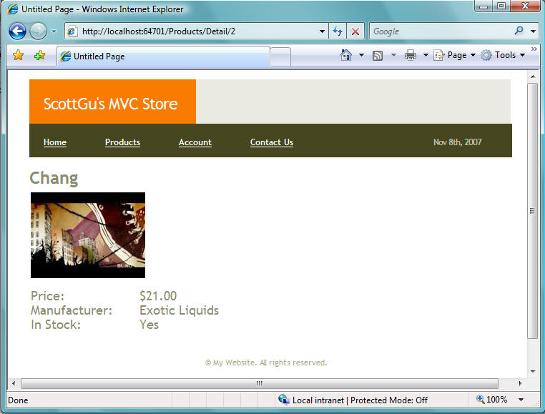
View:

Slide 10
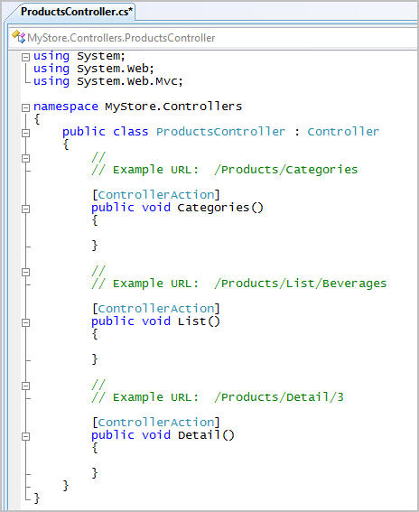
Controller:

Slide 11
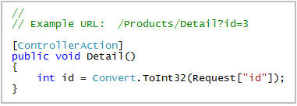
Controller

Slide 12
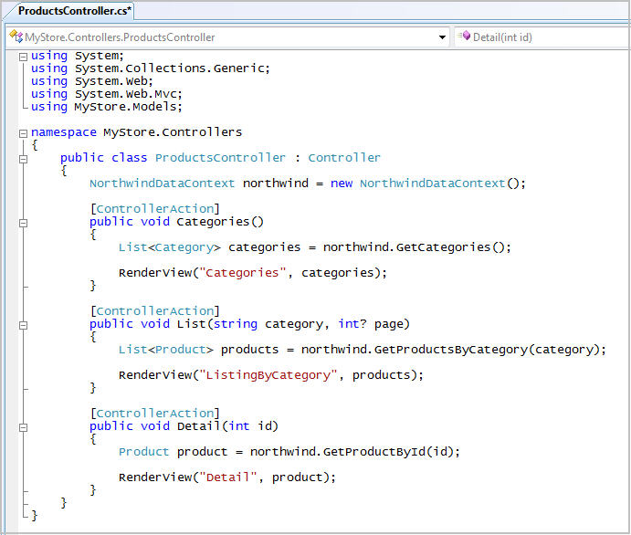

Slide 13
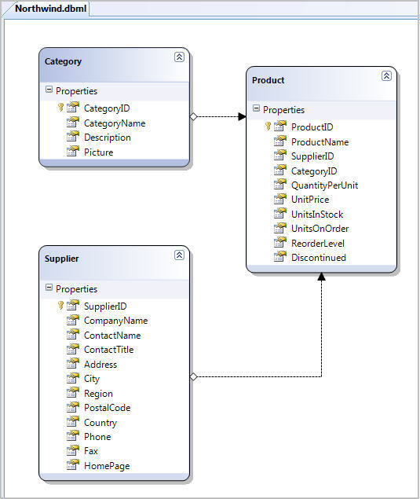
Model

Slide 14
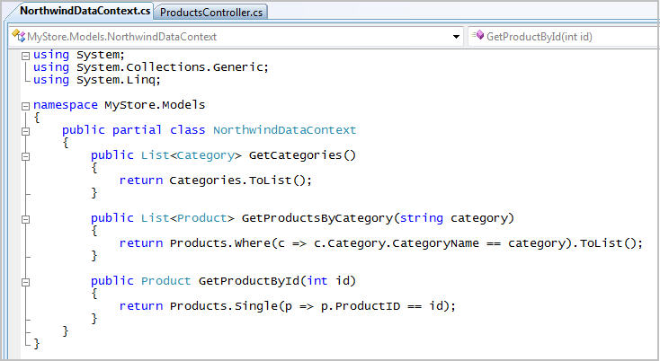
Model:

